Slide 1
Learning Objectives
LO5 Analyze transactions for operating a business into debit and credit parts.
© 2014 Cengage Learning. All Rights Reserved.

Slide 2
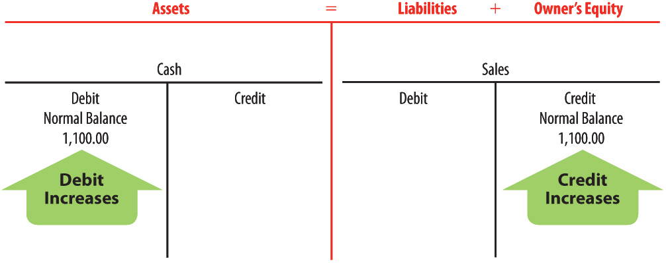
Received Cash from Sales
Lesson 2-3
LO5
January 10. Received cash from sales, $1,100.00.
2
1
Cash and Sales are affected.
Sales is a
revenue account
that affects
owner‘s equity.
Cash is an asset.
2
4
4
Cash is
debited.
Sales is credited.
3
Assets are increased.
3
Owner’s equity is increased.

Slide 3
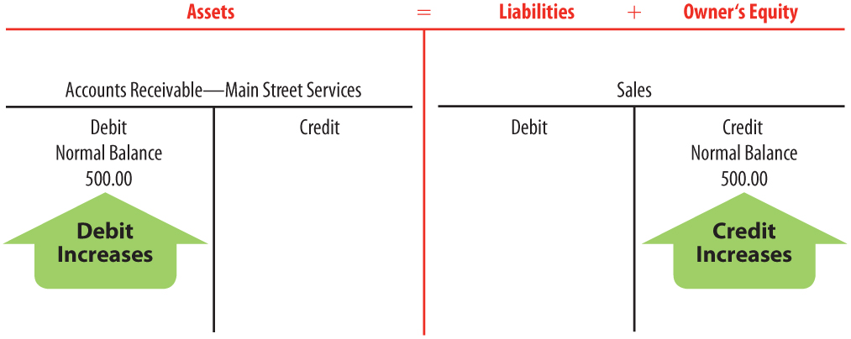
Sold Services on Account
Lesson 2-3
LO5
January 12. Sold services on account to Main Street Services, $500.00.
2
Accounts Receivable—
Main Street Services is an asset.
Accounts Receivable—Main Street Services and Sales are affected.
1
2
Sales is a
revenue
account
that affects
owner's
equity.
4
4
Accounts
Receivable—
Main Street
Services is
debited.
Sales is credited.
3
Assets are increased.
3
Owner’s equity is increased.

Slide 4
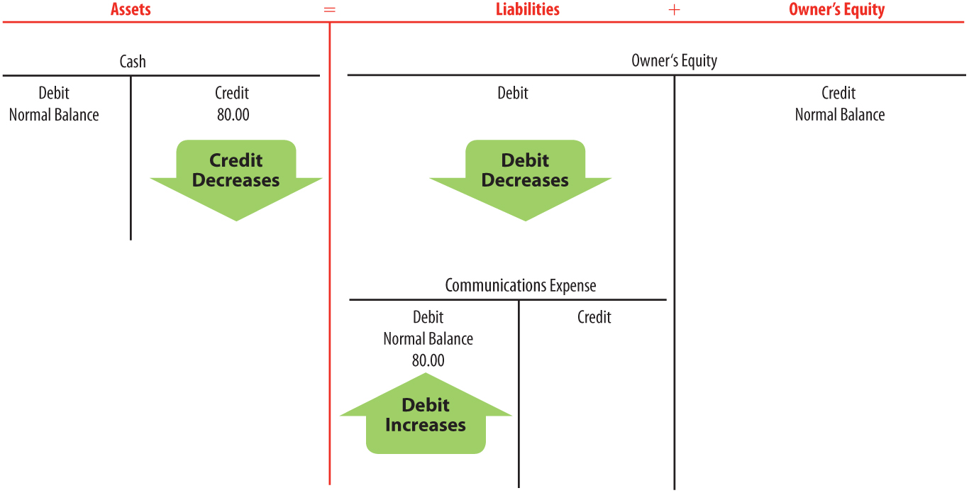
Paid Cash for an Expense
Lesson 2-3
LO5
January 12. Paid cash for communications bill for cell phone and Internet service, $80.00.
Communications Expense and Cash are affected.
Communications Expense is an expense account that affects owner‘s equity.
2
Cash is an asset.
1
2
4
Cash is credited.
Assets are
decreased.
3
Owner‘s equity is decreased; expenses are increased.
Communications
Expense is debited.
4
3

Slide 5
Received Cash on Account
Lesson 2-3
LO5
January 16. Received cash on account from Main Street Services, $200.00.
2
Cash and Accounts Receivable—
Main Street Services are assets.
1
Cash and Accounts Receivable—
Main Street Services are affected.
Assets
= Liabilities + Owner’s Equity
Accounts Receivable—
Main Street Services
is credited.
4
4
Cash is debited.
3
Assets (Cash) are increased.
3
Assets (Accounts Receivable—
Main Street Services) are decreased.

Slide 6
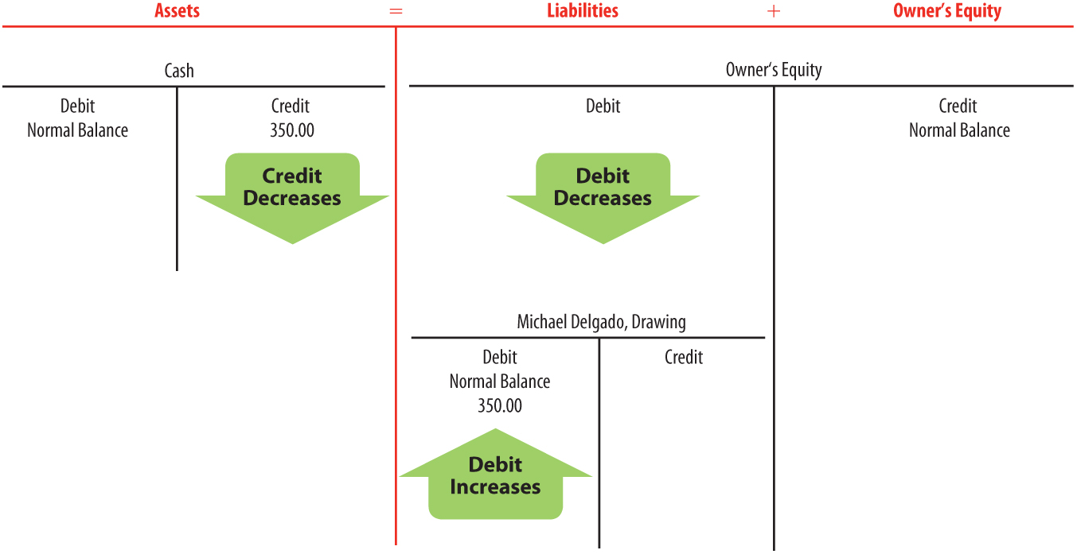
Paid Cash to Owner for Personal Use
Lesson 2-3
LO5
January 16. Michael Delgado withdrew equity in the form of cash, $350.00.
2
Cash is an asset.
1
Michael Delgado, Drawing and Cash are affected.
4
Cash is credited.
Michael Delgado, Drawing is an owner‘s equity account.
2
3
Assets are decreased.
4
Michael Delgado, Drawing is debited.
3
Owner’s equity is decreased; withdrawals are increased.

Slide 7
Lesson 2-3 Audit Your Understanding
Lesson 2-3
1. Which two accounts are affected when a business pays cash for a cell phone bill?
ANSWER
Communications Expense
Cash

Slide 8
Lesson 2-3 Audit Your Understanding
Lesson 2-3
2. Which two accounts are affected when a business sells services on account?
ANSWER
Accounts Receivable
Sales

Slide 9
Lesson 2-3 Audit Your Understanding
Lesson 2-3
3. Which two accounts are affected when a business receives cash on account?
ANSWER
Cash
Accounts Receivable

Slide 10
Lesson 2-3 Audit Your Understanding
Lesson 2-3
4. Is the drawing account increased on the debit side or credit side?
ANSWER
Debit because withdrawals decrease owner’s equity

Slide 11
Lesson 2-3 Audit Your Understanding
Lesson 2-3
5. Are revenue accounts increased on the debit side or credit side?
ANSWER
Credit because revenue increases owner’s equity

